Slide 1
Learning Theory

Slide 2
Bias/variance tradeoff
The generalization error of a hypothesis is its expected error on examples not necessarily in the training set.
Informally, we define the bias of a model to be the expected generalization error even if we were to fit it to a very large training set.
Apart from bias, there’s a second component to the generalization error, consisting of the variance of a model fitting procedure

Slide 3
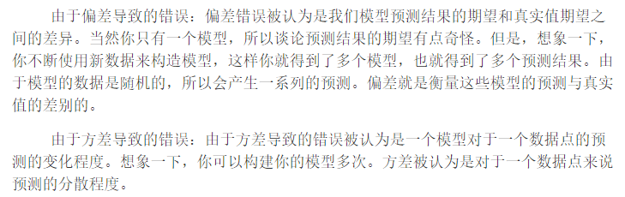
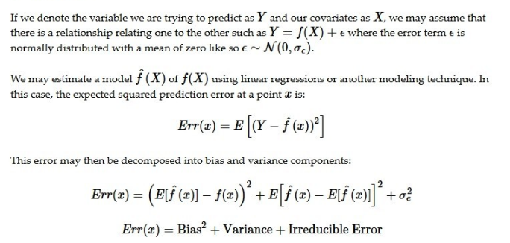

Slide 4
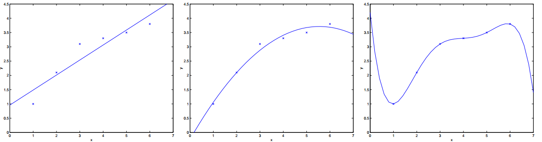
Often, there is a tradeoff between bias and variance.
If our model is too“simple” and has very few parameters, then it may have large bias (but smallvariance);
if it is too “complex” and has very many parameters, then it may suffer from large variance (but have smaller bias).

Slide 5

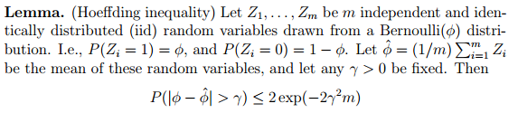

Preliminaries

Slide 6
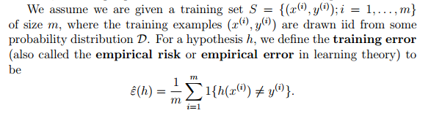

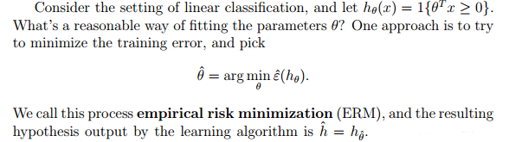

Slide 7
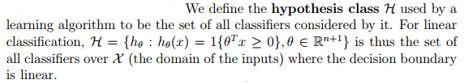



Slide 8
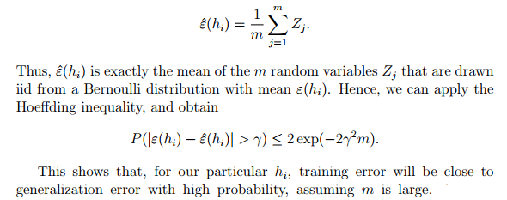
The case of finite H

Slide 9
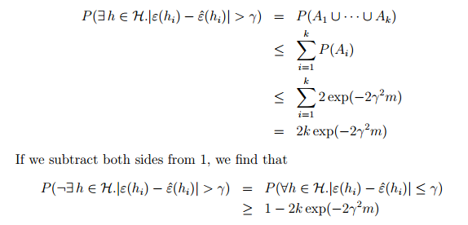

Slide 10
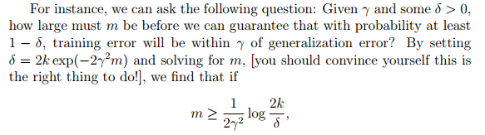

Slide 11
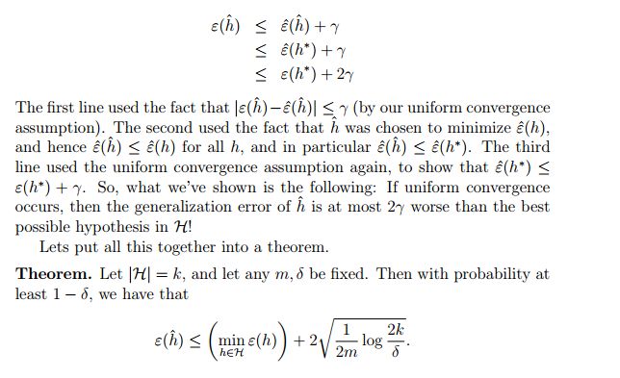


Slide 12
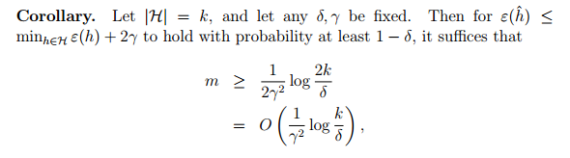

Slide 13
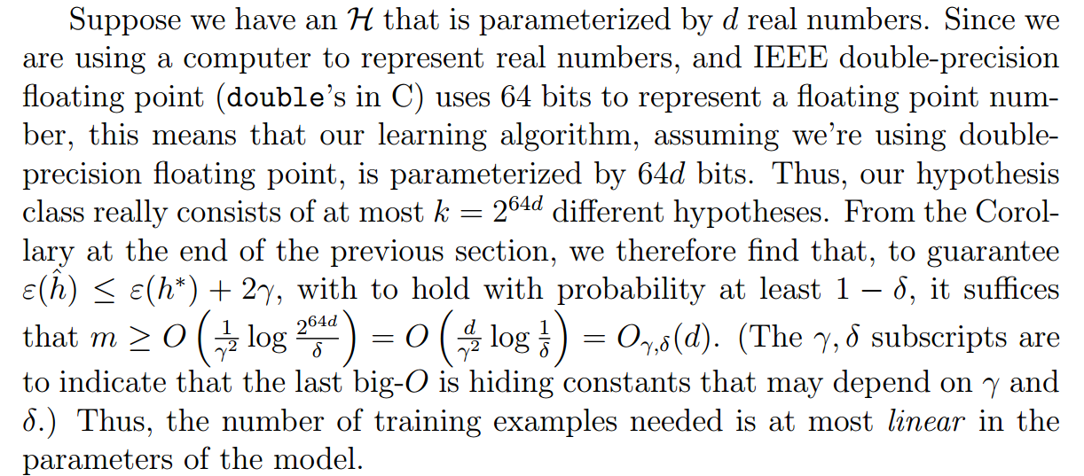
The case of infinite H

Slide 14
Vapnik-Chervonenkis dimension
Given a hypothesis class H, we then define its Vapnik-Chervonenkis dimension, written VC(H), to be the size of the largest set that is shattered by H.
Under the definition of the VC dimension, in order to prove that VC(H) is at least d, we need to show only that there’s at least one set of size d that H can shatter.

Slide 15
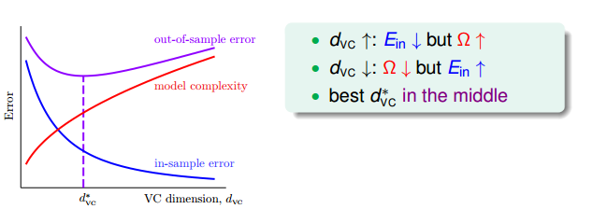
VC dimension的一种意义是表征着model complexity。

Slide 16
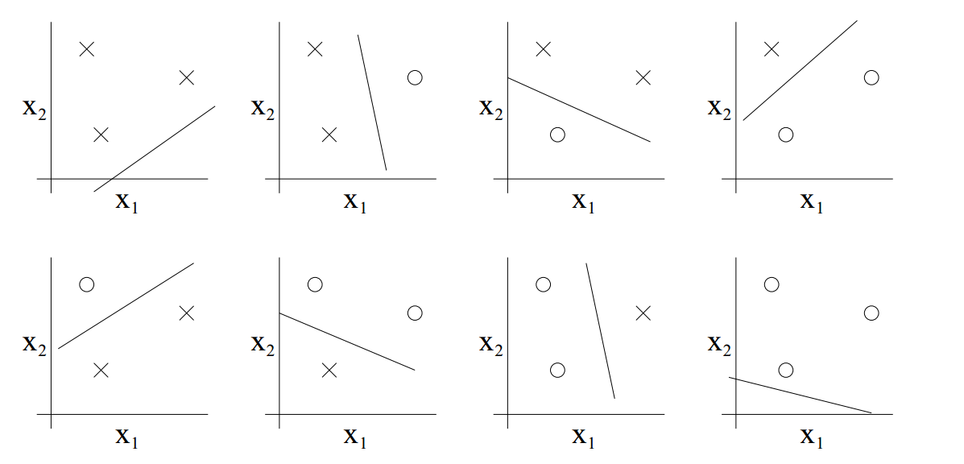
the set H of linear classifiers in two dimensions (h(x) = 1{θ0 +θ1x1 + θ2x2 ≥ 0}), Hence VC(H) = 3

Slide 17
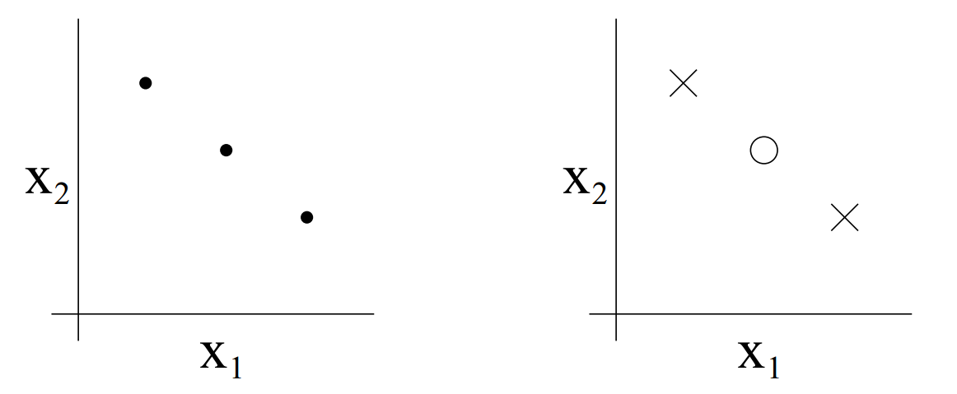
Note that the VC dimension of H here is 3 even though there may be sets of size 3 that it cannot shatter.

Slide 18
